Slide 1

Spring Boot - Rest Template
Post man client
SpringBootRestTemplateDemo
SpringBootDemo
DB
Using Rest Template Call the SpringBootDemo application
REST End points and get the result
Create/update/Get/Delete of Employee details

Slide 2
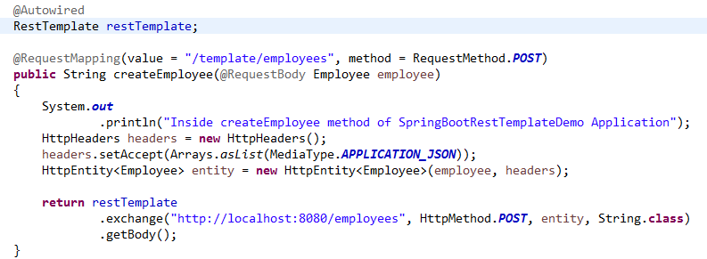
Spring Boot - Rest Template
We will have to follow the given points to consume the API −
Autowired the Rest Template Object.
Use HttpHeaders to set the Request Headers.
Use HttpEntity to wrap the request object.
Provide the URL, HttpMethod, entity and Return type for Exchange() method.
Rest Template is used to create applications that consume RESTful Web Services. You can use the exchange() method to consume the web services for all HTTP methods.

